Slide 1
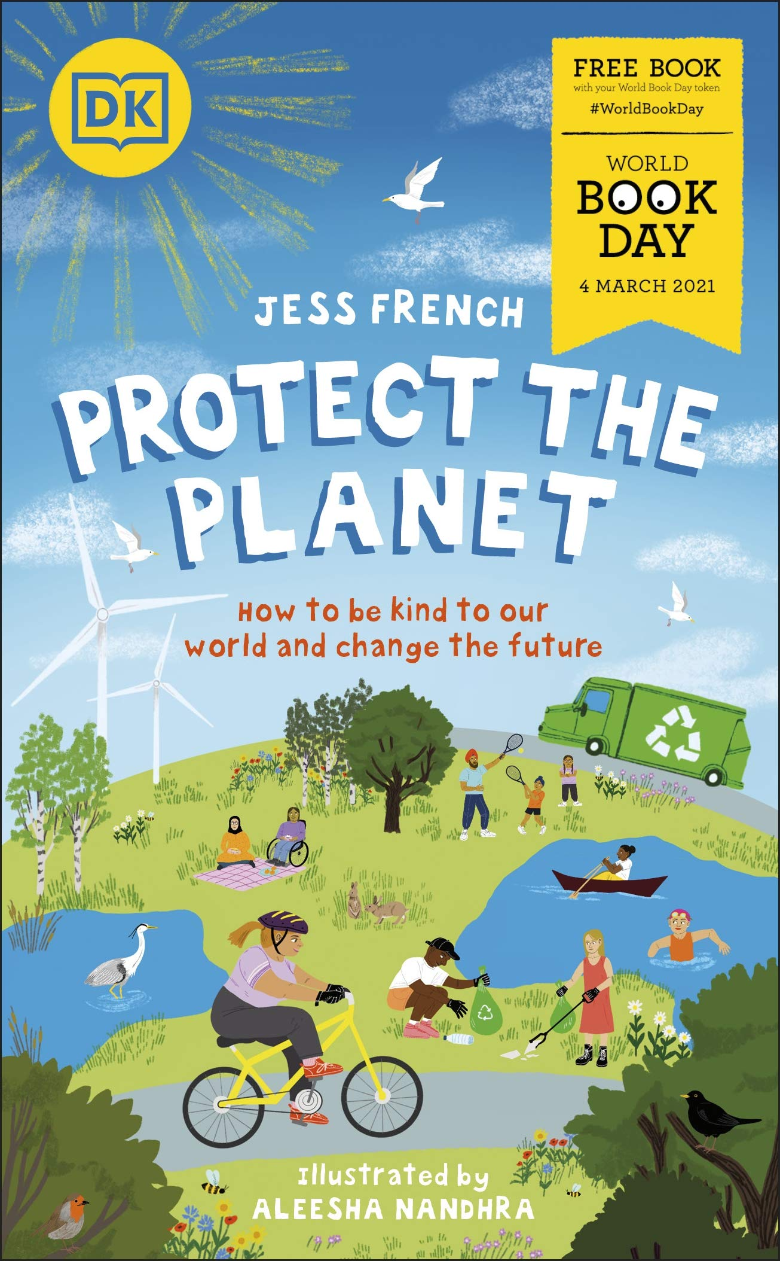
Protect the planet with jess French

Slide 2
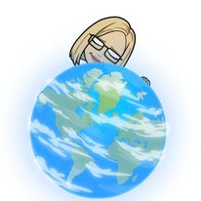
Activity one (optional)
Consider why the Earth is a beautiful place that deserves our protection. Split a sheet of paper into three sections – LAND, SEA and SKY – and write down or draw any words, ideas or images that you think of in the boxes.

Slide 3
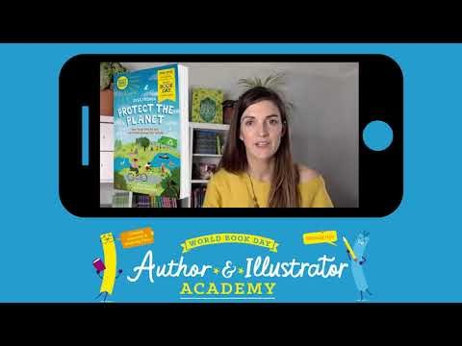
Watch the video link of Jess French

Slide 4

Activity two (optional)
Task - Read the book protect the planet which is on the school website. If you do not have time to read the whole book please just read p10- p13.
Answer the questions below
1. Is this book ‘fiction’ or ‘non-fiction’? What is the difference? How can you tell?
2. What does it mean that the Earth is ‘a perfect system’? Use pages 10–11 to help you.
3. What does Jess French mean when she says that we don’t always treat the planet ‘with kindness’?

Slide 5

Activity three (optional)
In the video, Jess talks about how making a few changes to your everyday life can have a huge impact on the planet – for example turning lights off, walking to school, and using less plastic.
•Task - Create a list of small changes and attach it somewhere you can see it (for example on the fridge at home!) With your family, tick off each time one of you makes a small change. Keep track of who makes the most changes each week!

Slide 6
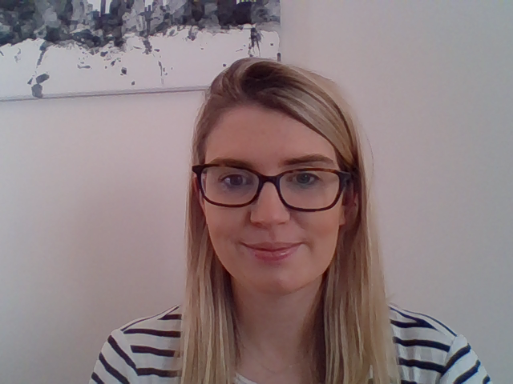
Assignment -choice one
Task – Write a poem about environmental issues
Write a poem about the impact environmental issues are having on the planet. Or you may want to write a poem about a world in which we solve all of the environmental issues that Jess talks about in her book.
You can write the poem in any style you like, acrostic, sense, limerick, rhyming or haiku.
Learning intention – I can write a poem about environmental issues
Sc- I can
Write the poem using one of the poetry styles we have learned about
Include adjectives
I can include alliteration or a simile

Slide 7
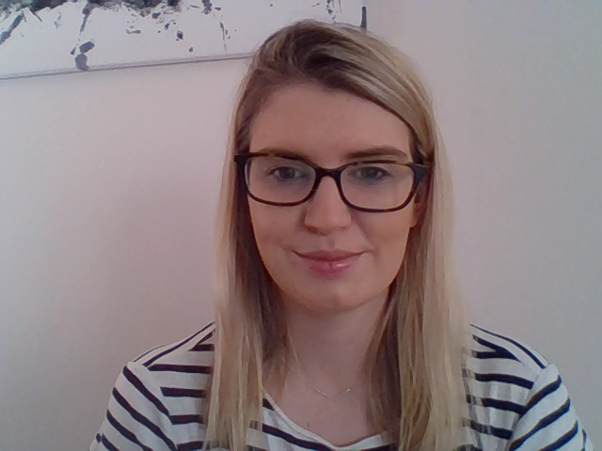
Assignment – choice two
Task - Create a story board showing how kindness can help save our planet.
In the book Protect the Planet Jess explains that ‘kindness is key’. By acting in a way that is kind to plants, animals, the environment, and other people, we have the power to save our planet.
LI – I can create a story board about being kind to the environment.
SC- I can include…
Detailed pictures
Sentences to describe each picture.
Ways that we can look after the environment by being kind.

