Slide 1
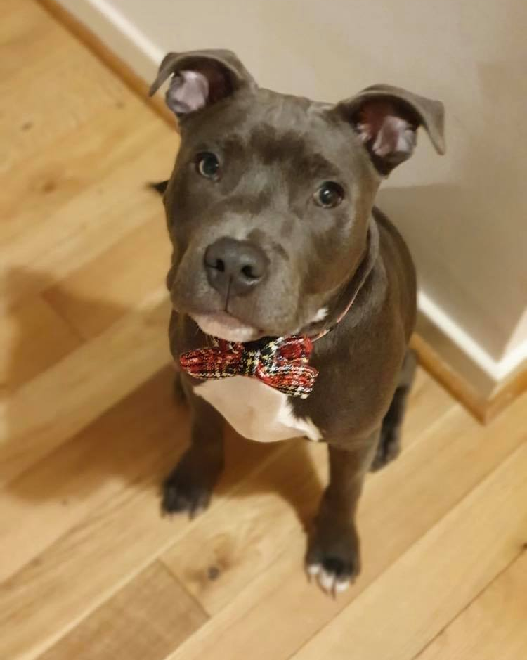

Missing operations ft. Otis

Slide 2
I NEED YOUR HELP

Slide 3
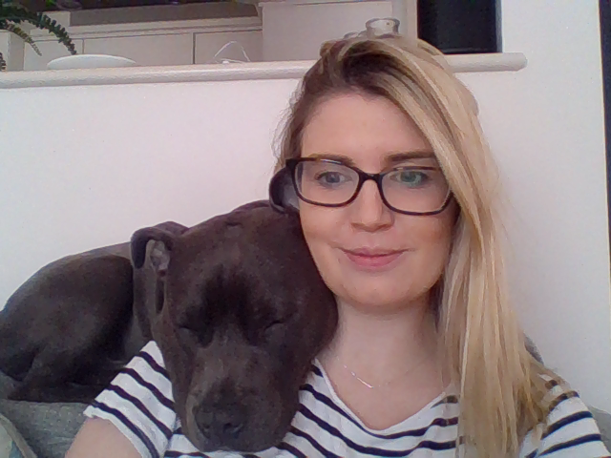
Otis has been being a nuisance and has eaten the mathematical operations symbols from the number questions.
Use your detective skills to show which number
operation is
missing……..

Slide 4
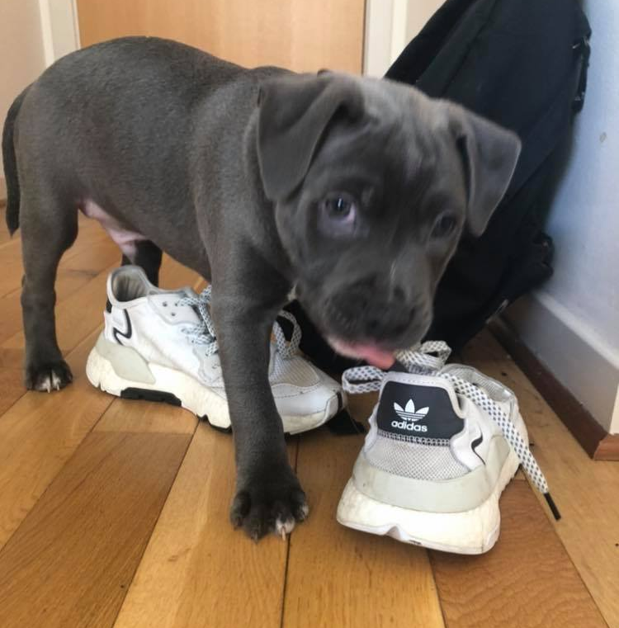
Don’t be fooled by his sleeping. He will eat anything!

Slide 5

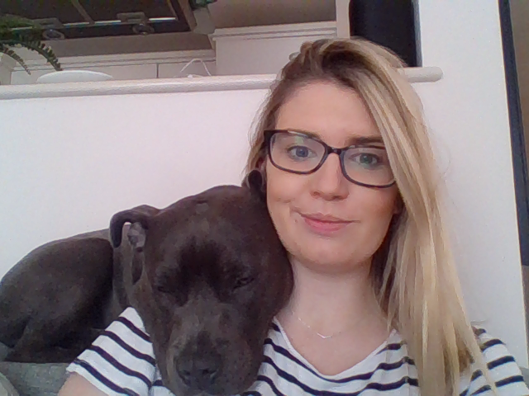
Which number operation symbol is missing?
10 18=28

Slide 6
Answer
10 18=28

Slide 7

Which number operation symbol is missing?
21 4 = 17

Slide 8
Answer
21 4 = 17

Slide 9
Which number operation symbol is missing?
99 33=66

Slide 10
Answer
99 33=66

Slide 11
Which number operation symbol is missing?
5 5 = 25

Slide 12
Answer
5 5 = 25

Slide 13
Which number operation symbol is missing?
100 10=10

Slide 14

Answer
100 10=10

Slide 15

Which number operation symbol is missing?
36 6 = 6

Slide 16
Answer
36 6 = 6

Slide 17
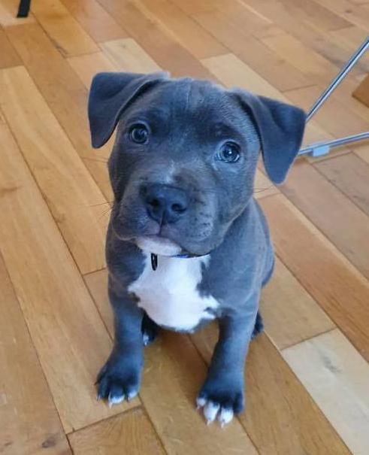
I am sorry I ate the number operations.
Miss Doig told me to put them back into these Math problems but I don’t know which number operation to use to solve them.
Please help me and tell me which number operation to use.
?

Slide 18
A bus seats 30 people. No standing is allowed.
15 people get off a full bus. How many were left on?
Which number operation?

Slide 19
Sally bought 20 stamps in one packet, 10 in another and 15 in a third packet.
How many did she get altogether ?
Which number operation?

Slide 20
I have read 75 pages of the 100 pages in my book.
How many more pages must I read to reach the end?
Which number operation?

Slide 21
If 120 cars are shared equally among 10 boys how many will one boy get?
Which number operation?

Slide 22
One farmer has 16 lambs and another has 20.
How many lambs are there altogether?
Which number operation?

Slide 23
Kobi saved 10p a week for one year.
How many pounds did he save?
Which number operation?

Slide 24
On the school trip there were 12 children from year 3, 13 children from year 4 and 4 members of staff.
How many people went on the trip altogether?
Which number operation?

Slide 25
There are 52 children in the school. 25 are girls, how many are boys?
Which number operation?

Slide 26
We planted 11 rows of apple trees, with 7 trees in each row.
How many trees were there altogether ?
Which number operation?

Slide 27
Emma shared out 48 sweets to her friends, they had 8sweets each.
How many friends did she give them to?
Which number operation?

