Slide 1
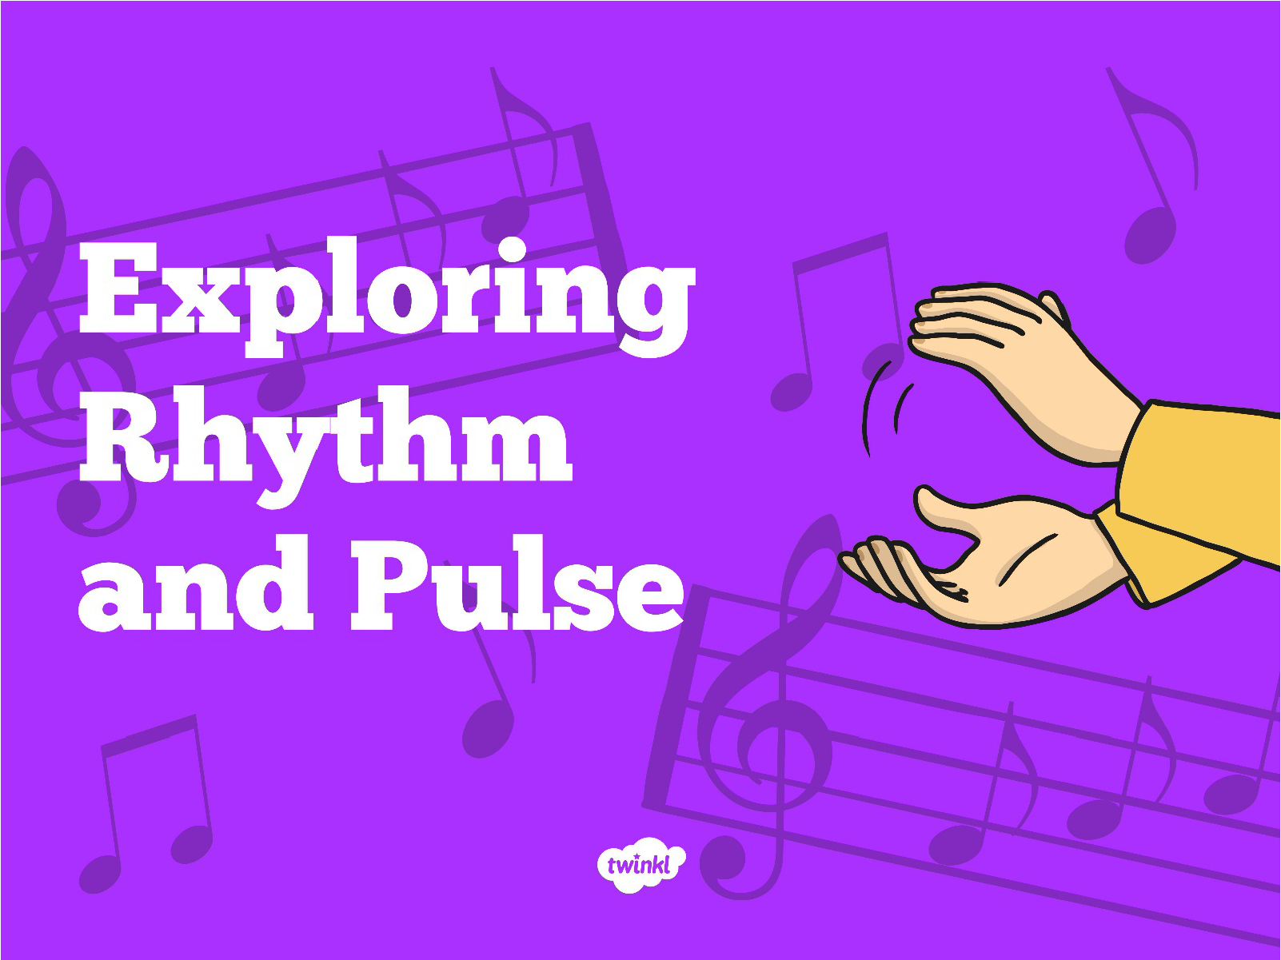

Slide 2
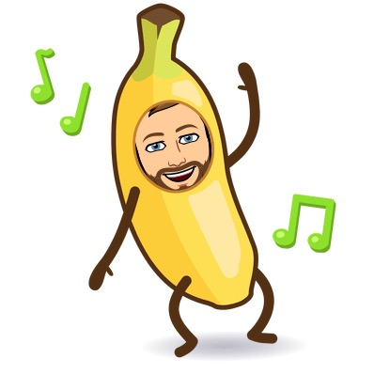
Learning Intention: I can follow and create my own rhythm.
Success Criteria:
I can count and clap to a beat.
I can use multiple beats together within the same rhythm.
I can create my own rhythm.

Slide 3
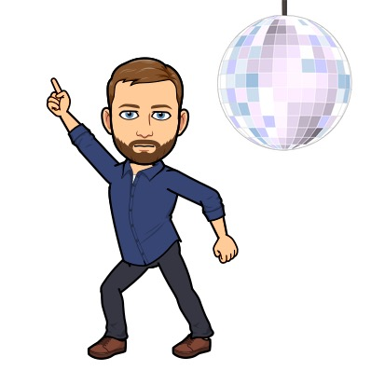
Have a go at following these rhythms using your hands, feet and voice…
Being able to follow a beat is really important! It helps you to sing along to your favourite music, create your own songs and most importantly for Mr Clark, it helps you to dance in time to your favourite tunes!

Slide 4
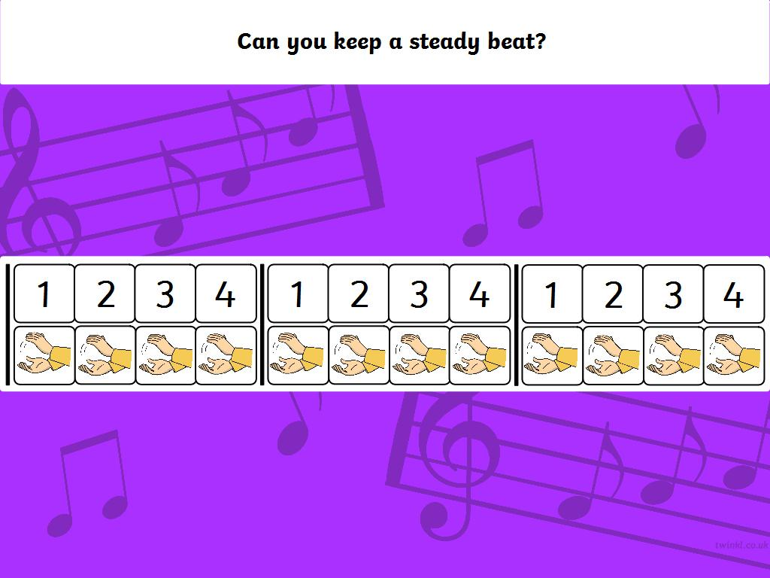


Slide 5
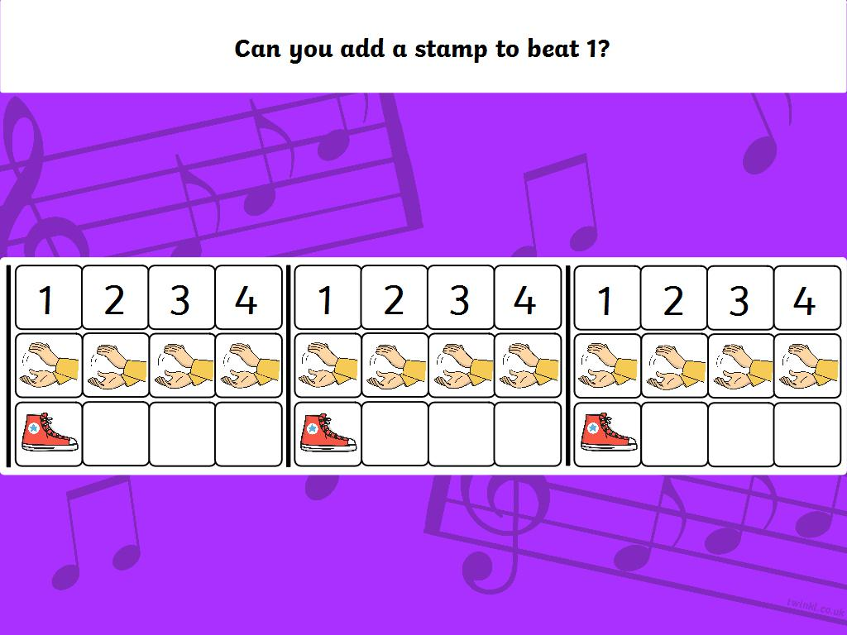

Slide 6
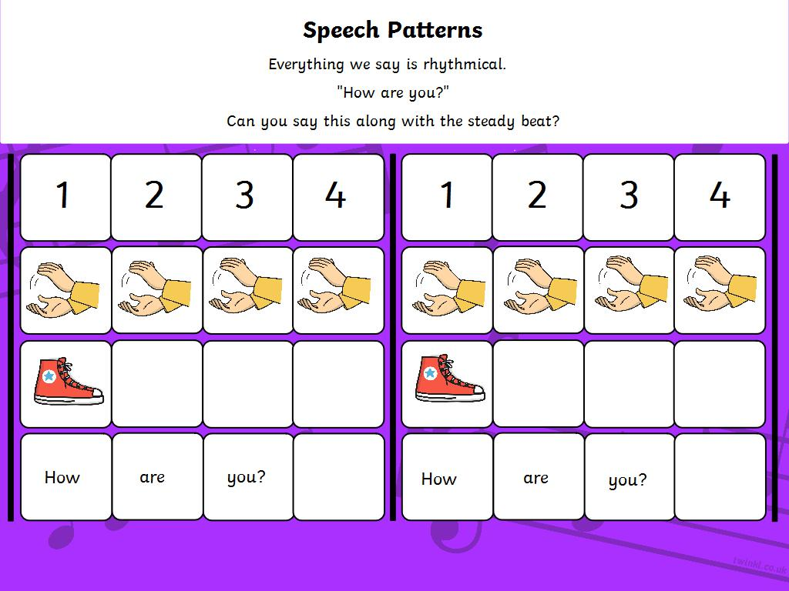

Slide 7
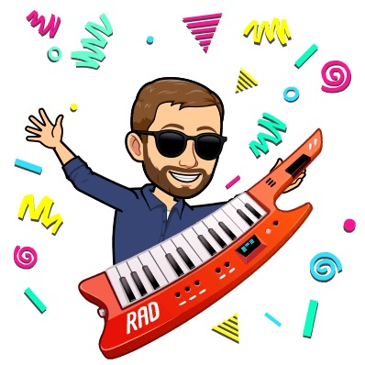
Grab a partner! A brother, Sister or Parent will do! Take turns of being the caller!

Slide 8
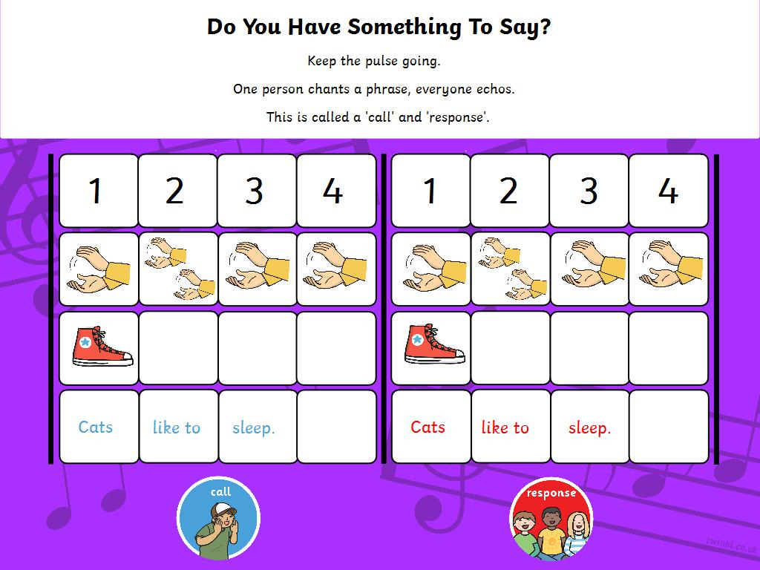

Slide 9
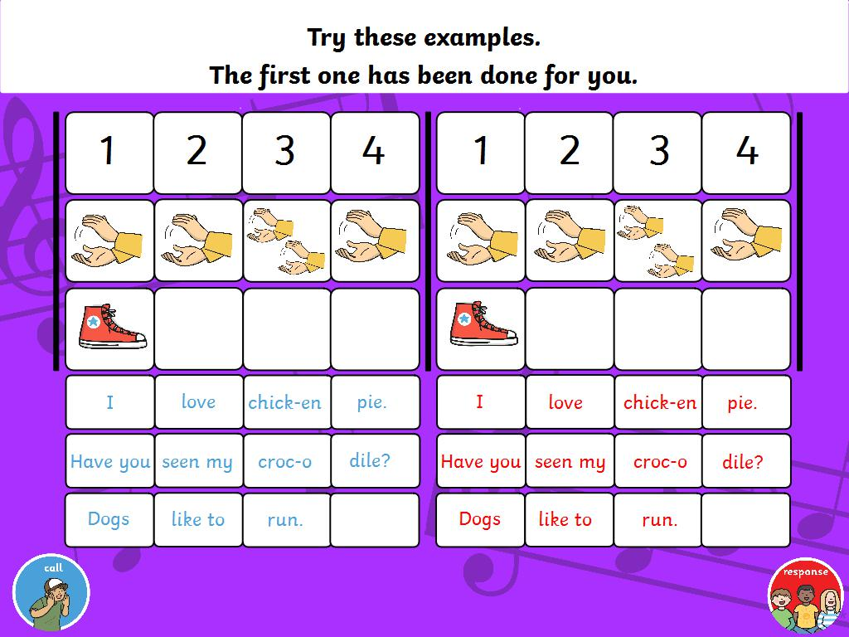

Slide 10
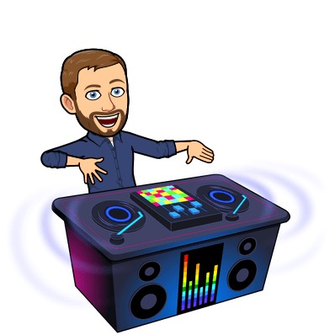
Get creative!
Using what you have learned about rhythm, create your own piece of music including at least two different types of beat and also some lyrics.
If you want you can post a video of your piece of music to the Teams channel and see if classmates can respond to your call!
You may wish to draw your piece of music out in the same way you are shown on the next slide.

Slide 11
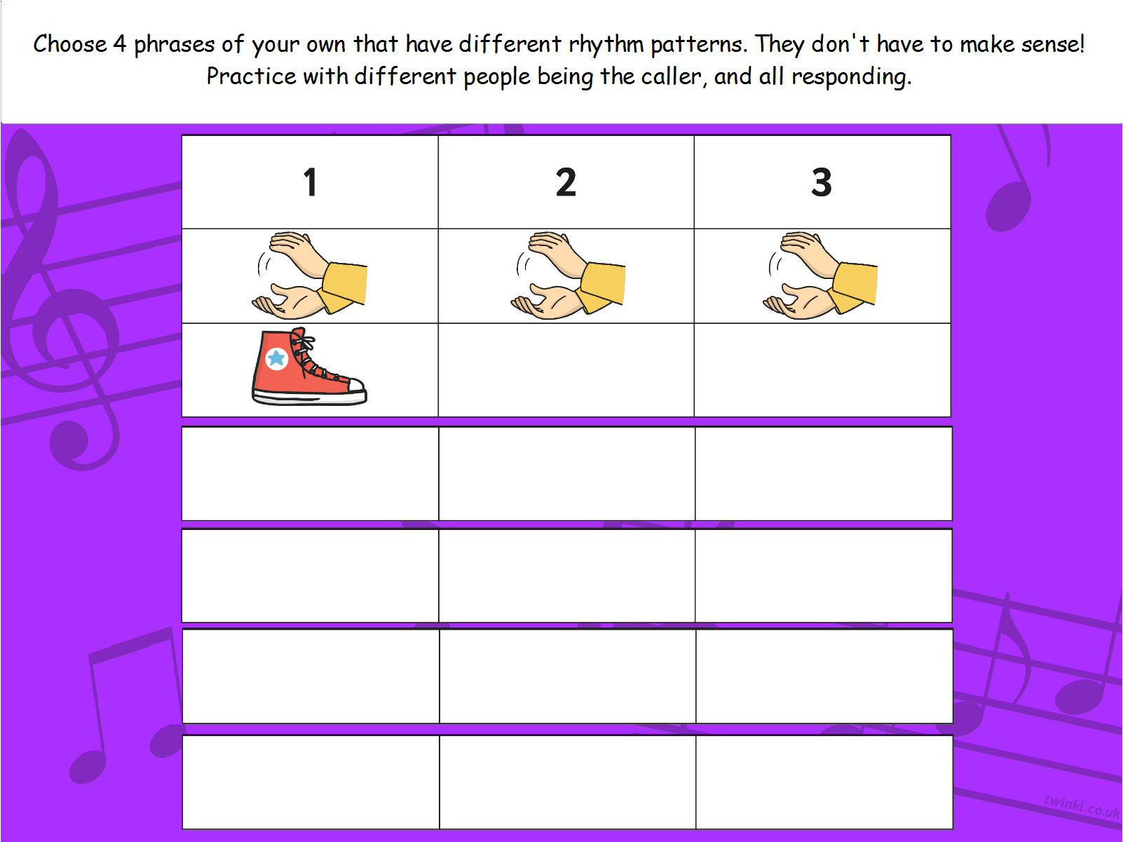


Choose 4 phrases of your own that have different rhythm patterns. They don’t have to make sense! Practise with different people being the caller, and all responding.
1 | 2 | 3 | 4

Slide 12
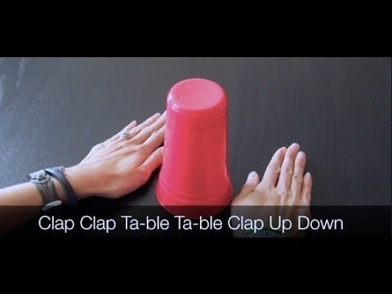
Bonus Challenge: Have a go at this challenge. All you need is a cup and your voice!

