Slide 1
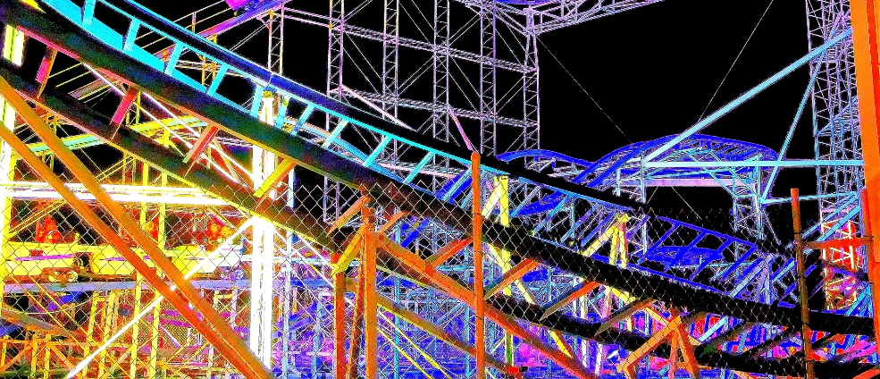


Metaphors
Learning Intention:
I can recognise and use different metaphors.

Slide 2

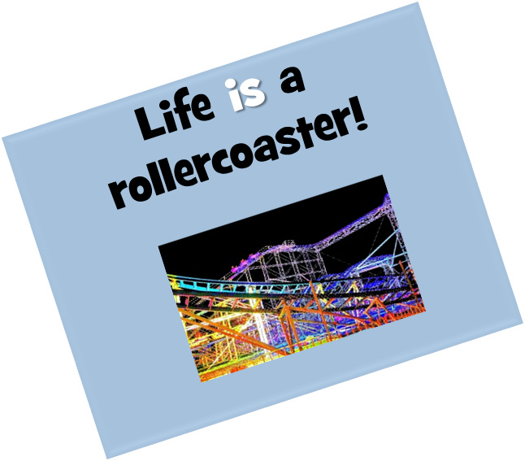
This metaphor compares life with a rollercoaster. It says life is a roller coaster. It has its ups and downs and can be scary and yet exciting. Much is conveyed in a few words.
Notes:
https://www.flickr.com/photos/kim_carpenter_nj/7565537700

Slide 3

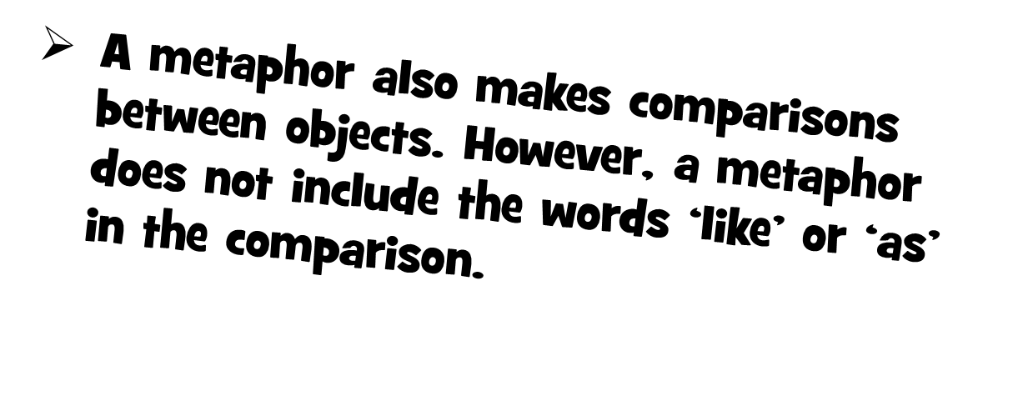

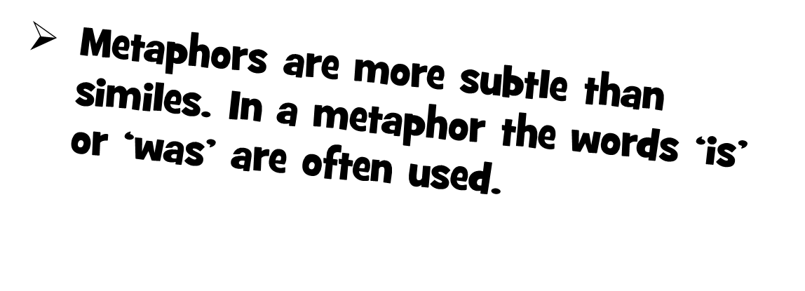
Notes:
https://www.flickr.com/photos/kim_carpenter_nj/7565537700

Slide 4

Other metaphor examples:
She is a shining star!
Custard is a bowl of happiness!
He has the heart of a lion!

Slide 5



Task 1

Slide 6

Task 2
https://www.bbc.co.uk/bitesize/topics/zfkk7ty/articles/z9tkxfr
Have a look at this clip and have a go at the quiz to test yourself on the differences between a metaphor and a simile.

