Slide 1
UNCRC Our Rights

Slide 2
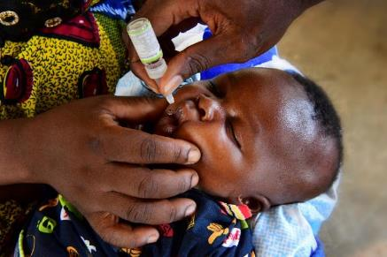
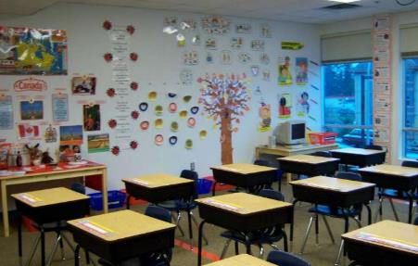
Guess the articles
These pictures provide a clue to this week’s articles.
Can you guess how they are linked together? Which articles of the Convention do these pictures relate to?
Write down your thoughts or discuss with someone in your home.
Unicef/Faso
WikiCommons
WikiCommons
Notes:
From left to right:
1. Mumbai, India, December 2018: Members of the transgender community in India and allies protesting against the regressive provisions of the Transgender (Protection of Rights) Bill. Wikicommons
2. Recently married couples leaving the City Hall in Seattle are greeted by well-wishers on the first day of same-sex marriage in Washington state after enactment of Washington Referendum 74 Dennis Bratland/Wikicommons
3. Baltimore, US, July 2016: An image from a Black Lives Matter march through downtown Baltimore City. John Lucia/Wikicommons – licence: https://creativecommons.org/licenses/by/2.0/deed.en

Slide 3
Introducing… Article 24 & 28
Kathy introduces Article 24 & 28
Article 24 – Health care ensures that every child has the right to the best possible health
Governments must provide good quality health care, clean water, nutritious food, and a clean environment and education on health and well-being so that children can stay healthy. Richer countries must help poorer countries achieve this.
Article 28 - Every child has the right to an education
Primary education must be free and different forms of secondary education must be available to every child. Discipline in schools must respect children’s dignity and their rights. Richer countries must help poorer countries achieve this
Watch Kathy on YouTube

Slide 4
Article 24: The right to good health care
This also links to Global goal 3, Good health and wellbeing
https://www.youtube.com/watch?v=JMfDkjO2ZcE

Slide 5
Article 28: The right to education
This also links to Global goal 4, Quality Education
https://www.youtube.com/watch?v=1wy1hwZgHdA

Slide 6
Task: Create a poster
The rights respecting group would like you to help them raise awareness of article 24 and article 28.
Please create a poster providing information about these rights.
You could include how we can keep healthy whilst at home. You could include tips for home learning.
Please send your poster to your class teacher on show and tell. When you post it please write twitter beside it if you would like your teacher to share it on twitter to help raise awareness of these rights.

Slide 7
LI: I can create an informative poster
Success criteria:
I can include articles 24 and 28 and explain what they are.
I can provide tips for looking after our health and education during lockdown.
I can include headings and sub headings.
I can include pictures.
Optional – I can include global goal 3 and 4.

